Slide 1

Develop models to estimate the lifetime value of customers based on usage patterns and demographics
Siri Chandana Dhurjati
W9621119
Notes:
Good Morning, I hope you are doing well!

Slide 2
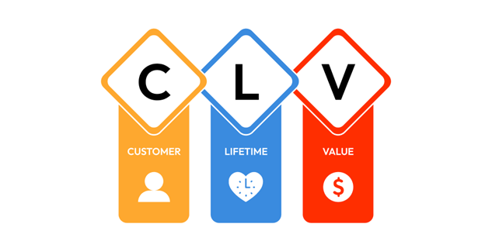
Introduction and Problem Statement
The research focuses on conventional Customer Lifetime Value calculation issues, such as outmoded techniques and data constraints. Using Machine Learning combines demographics and behavioural patterns for improved prediction accuracy, which helps businesses make informed decisions on marketing, customer relationships, and resource allocation.
Problem Statement
No behavioral data for Customer Lifetime Value methods currently.
Challenges: Static Models, Outdated Data, Low Accuracy
Solution: Advance Machine Learning with real time and demographic integration

Slide 3
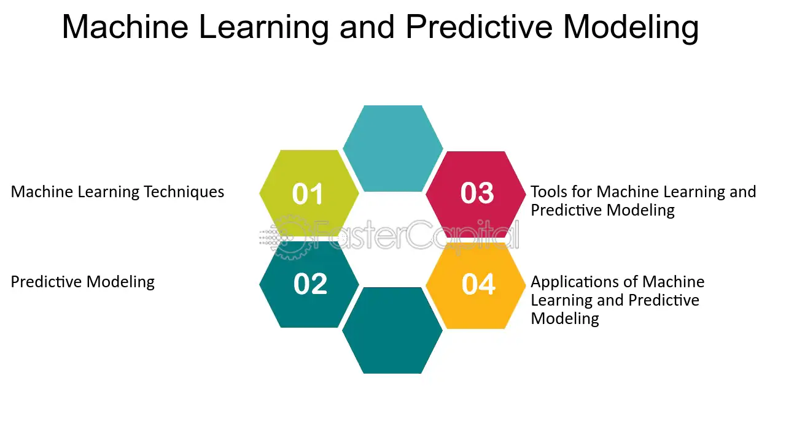
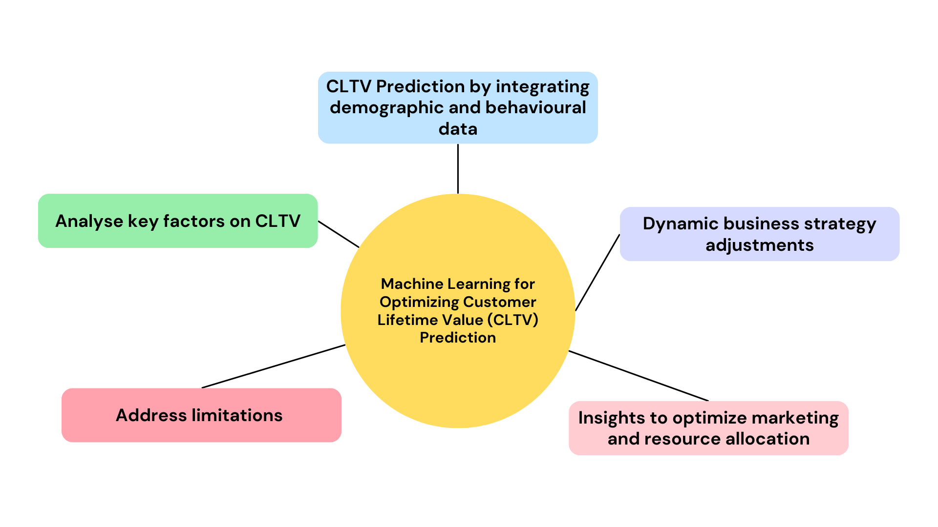
Research Aim and Objectives
Aim:
To develop advanced machine learning models for accurately estimating Customer Lifetime Value by incorporating demographic data, usage patterns, and behavioural insights to enhance predictive capabilities and support strategic business decisions.
Objectives:
Improve Machine Learning models.
Get to know engagement-value connections
Tackle address estimation issues

Slide 4
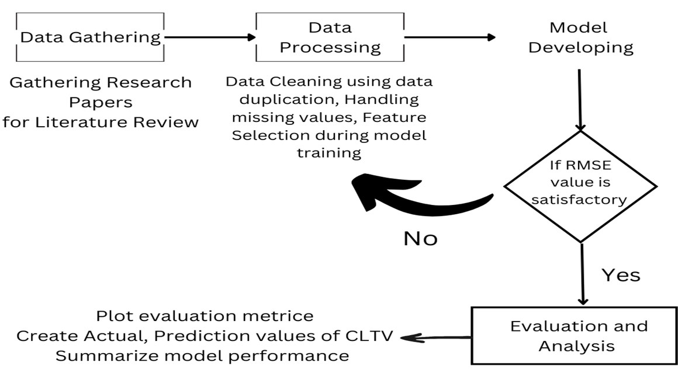
Proposed Solutions and Research Methodology
The project successfully addressed limitations in conventional CLTV(Customer Lifetime Value) estimation by incorporating both demographic and behavioral data, enabling more accurate predictions.
Models like Random Forest, XGBoost and Decision Tree Regression demonstrated outstanding performance with low error rates and high predictive accuracy, accounting for most of the variation in CLTV. This was affirmed through detailed analysis of evaluation metrics, such as RMSE (Root Mean Square Error) and R², which showcased the models’ reliability and practicality.
The comparisons highlighted Random Forest’s superior capability in handling non-linear relationships and dynamic customer behaviors, establishing its utility for businesses aiming to improve customer retention, optimize marketing strategies, and make data-driven decisions with confidence.

Slide 5
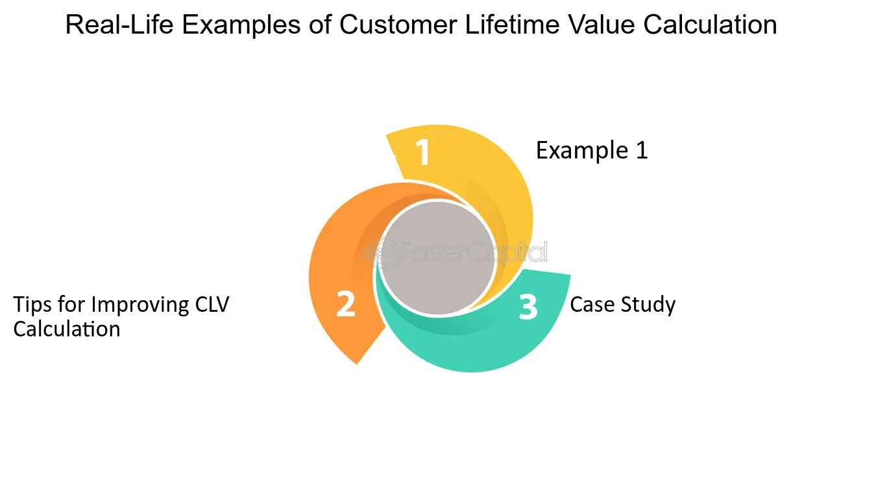
Literature Review Insights
Main terms: Importance of Customer Lifetime Value, Customer engagement, and behavior.
Gaps: Inconsistent data, limited real-time inputs, limited Machine Learning delivery
Trends to watch: RFM(Recency, Frequency, and Monetary Value), ensemble Machine Learning methods.

Slide 6
Algorithms Used
Linear Regression
Simple and interpretable, making it a good baseline model for predicting Customer Lifetime Value with linear relationships.
Decision Tree Regressor
Captures non-linear patterns and interactions in the data, offering flexibility for more complex relationships in Customer Lifetime Value prediction.
Random Forest
Combines multiple decision trees to reduce overfitting, providing robust predictions with improved accuracy and stability.
AdaBoost
Regressor
Focuses on improving weak models, boosting performance by reducing bias and handling noisy data well in Customer Lifetime Value prediction.
XGBoost Regressor
A highly efficient gradient boosting algorithm that optimizes both bias and variance, often delivering state-of-the-art performance for Customer Lifetime Value predictions.

Slide 7
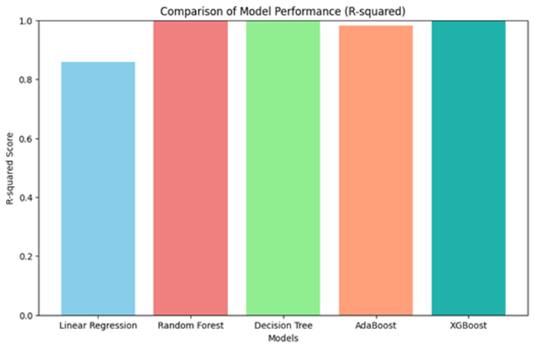
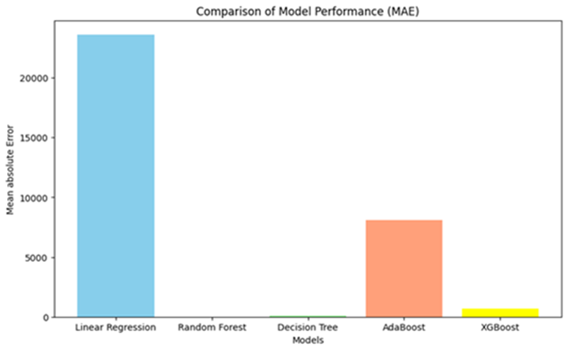
Model Performance Comparison
Model | Root mean squared error (RMSE) | R² | Mean absolute error (MAE) | Mean squared error (MSE)
Linear Regression | 33732.76 | 0.85 | 23619.33 | 1137899557.54
Random Forest | 50.10 | 0.99 | 5.31 | 2510.77
Decision Tree Regressor | 306.40 | 0.99 | 95.52 | 93886.27
AdaBoost Regressor | 12117.86 | 0.98 | 8116.48 | 146842709.33
XGBoost Regressor | 3059.94 | 0.99 | 670.75 | 9363271.57

Slide 8

Business Implications
Benefits: Better marketing, retention, allocation of resources.
Recommendation's: Increase investment into Machine Learning, real-time data and expanding features.
Difficulties: Type of data, quality of data, model interpretability.

Slide 9
Conclusion and Future Perspectives
Future:
Real-time data, explainable AI(Artificial Intelligence), and sector-specific models.
Then you should adopt ensemble models like XG Boost and Random Forest.
Incorporate real-time data.
Develop unified data systems.
Optimize models continuously.
Conclusion:
Machine Learning improves Customer Lifetime Value estimation and decision-making.
Traditional methods are surpassed by ensemble models.
Actionable insights for maximizing the value of the customer.
Goal:
Drive innovation in customer analytics.

Slide 10
Reference
Schröer, C., Kruse, F. and Gómez, J.M., 2021. A systematic literature review on applying CRISP-DM process model. Procedia Computer Science, 181, pp.526-534.
Snyder, H., 2019. Literature review as a research methodology: An overview and guidelines. Journal of business research, 104, pp.333-339.
Charbuty, B. and Abdulazeez, A., 2021. Classification based on decision tree algorithm for machine learning. Journal of Applied Science and Technology Trends, 2(01), pp.20-28.
Whittemore, R. and Knafl, K., 2005. The integrative review: updated methodology. Journal of advanced nursing, 52(5), pp.546-553.
Navada, A., Ansari, A.N., Patil, S. and Sonkamble, B.A., 2011, June. Overview of use of decision tree algorithms in machine learning. In 2011 IEEE control and system graduate research colloquium (pp. 37-42). IEEE.

Slide 11


